Slide 1

2e sprint review
Groep: Brayden Bos, Bram de Vries, Jah Sanches

Slide 2
inleiding
Unity
Blender
Teamwork
Git/Trello

Slide 3

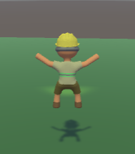
Unity
New Camera System
Animation

Slide 4

Blender
TEX
MAT
Animations

Slide 5
Teamwork
Goed
Slecht

Slide 6

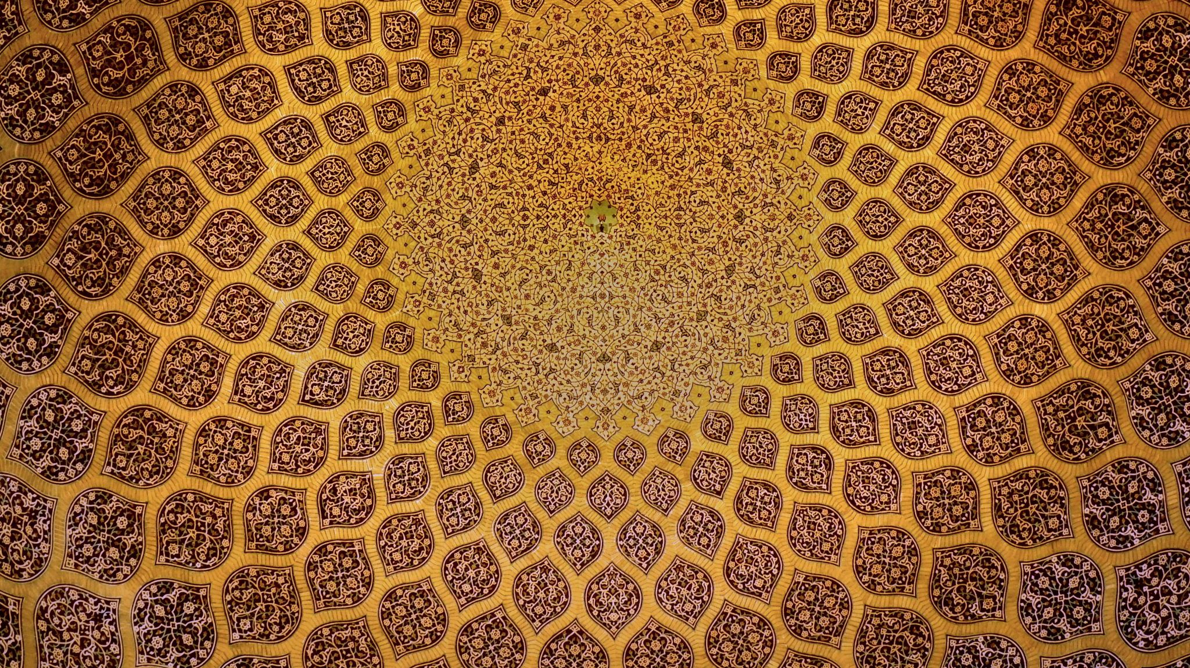



Git/Trell

Slide 7

Vragen

